Slide 1
以太网

Slide 2
Ethernet
History
Developed by Bob Metcalfe and others at Xerox PARC in mid-1970s
Roots in Aloha packet-radio network
Standardized by Xerox, DEC, and Intel in 1978
LAN standards define MAC and physical layer connectivity
IEEE 802.3 (CSMA/CD - Ethernet) standard – originally 2Mbps
IEEE 802.3u standard for 100Mbps Ethernet
IEEE 802.3z standard for 1,000Mbps Ethernet
CSMA/CD: Ethernet’s Media Access Control (MAC) policy
CS = carrier sense
Send only if medium is idle
MA = multiple access
CD = collision detection
Stop sending immediately if collision is detected

Slide 3
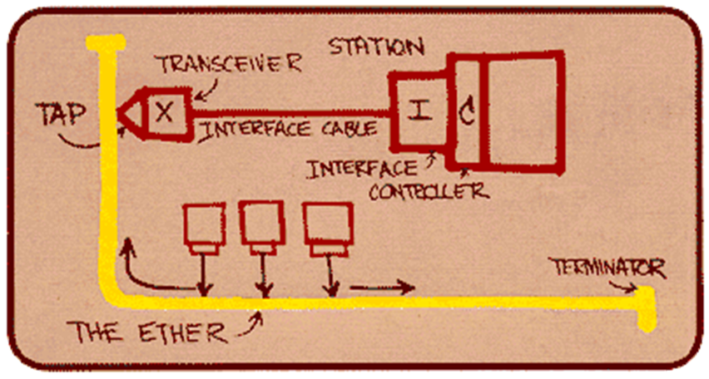
Ethernet
“dominant” wired LAN technology:
cheap $20 for NIC
first widely used LAN technology
simpler, cheaper than token LANs and ATM
kept up with speed race: 10 Mbps – 10 Gbps
Metcalfe’s Ethernet
sketch

Slide 4
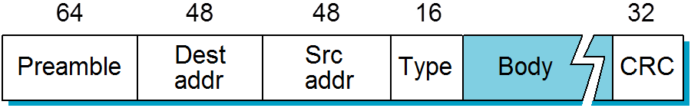
Ethernet Frame Structure
Sending adapter encapsulates IP datagram (or other network layer protocol packet) in Ethernet frame
Preamble:
7 bytes with pattern 10101010 followed by one byte with pattern 10101011
used to synchronize receiver, sender clock rates

Slide 5
Ethernet Frame Structure (more)
Addresses: 6 bytes
if adapter receives frame with matching destination address, or with broadcast address (eg ARP packet), it passes data in frame to network layer protocol
otherwise, adapter discards frame
Type: indicates higher layer protocol (mostly IP but others possible, e.g., Novell IPX, AppleTalk)
CRC: checked at receiver, if error is detected, frame is dropped

Slide 6
Ethernet uses CSMA/CD
No slots
adapter doesn’t transmit if it senses that some other adapter is transmitting, that is, carrier sense
transmitting adapter aborts when it senses that another adapter is transmitting, that is, collision detection
Before attempting a retransmission, adapter waits a random time, that is, random access

Slide 7
Ethernet CSMA/CD algorithm
1. NIC receives datagram from network layer, creates frame
2. If NIC senses channel idle, starts frame transmission If NIC senses channel busy, waits until channel idle, then transmits
3. If NIC transmits entire frame without detecting another transmission, NIC is done with frame !
4. If NIC detects another transmission while transmitting, aborts and sends jam signal
5. After aborting, NIC enters exponential backoff: after mth collision, NIC chooses K at random from {0,1,2,…,2^{m}-1}. NIC waits K·512 bit times, returns to Step 2

Slide 8
Exponential Backoff
If a collision is detected, delay and try again
Delay time is selected using binary exponential backoff
1st time: choose K from {0,1} then delay = K * 51.2us
2nd time: choose K from {0,1,2,3} then delay = K * 51.2us
nth time: delay = K x 51.2us, for K=0..2^{n} – 1
Note max value for k = 1023
give up after several tries (usually 16)
Report transmit error to host
If delay were not random, then there is a chance that sources would retransmit in lock step
Why not just choose from small set for K
This works fine for a small number of hosts
Large number of nodes would result in more collisions

Slide 9
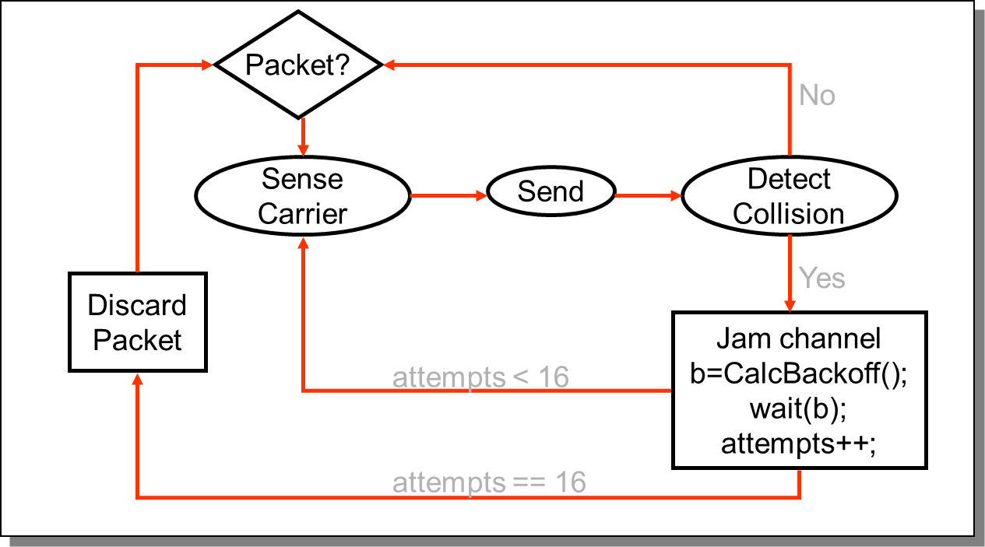
State Diagram for CSMA/CD

Slide 10
CSMA/CD efficiency
T_{prop} = max prop delay between 2 nodes in LAN
t_{trans} = time to transmit max-size frame
efficiency goes to 1
as t_{prop} goes to 0
as t_{trans} goes to infinity
better performance than ALOHA: and simple, cheap, decentralized!

Slide 11
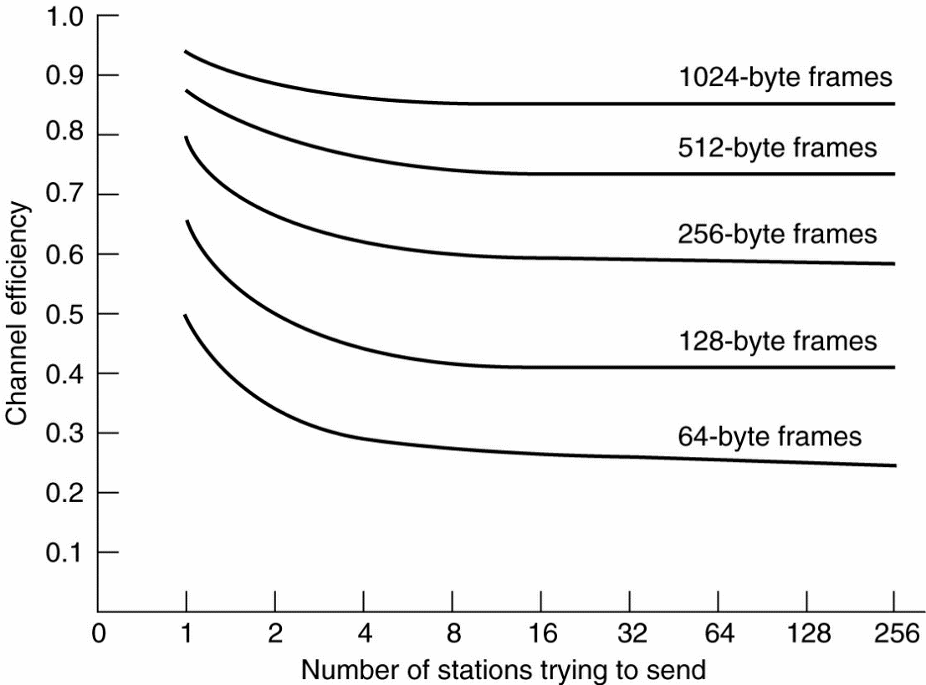
Ethernet Performance
Efficiency of Ethernet at 10 Mbps with 512-bit slot times.

Slide 12
802.3 Ethernet Standards: Link & Physical Layers
many different Ethernet standards
common MAC protocol and frame format
different speeds: 2 Mbps, 10 Mbps, 100 Mbps, 1Gbps, 10G bps
different physical layer media: fiber, cable
MAC protocol
and frame format
application
transport
network
link
physical
100BASE-TX
100BASE-T2
100BASE-FX
100BASE-T4
100BASE-SX
100BASE-BX
copper (twister
pair) physical layer
fiber physical layer

Slide 13
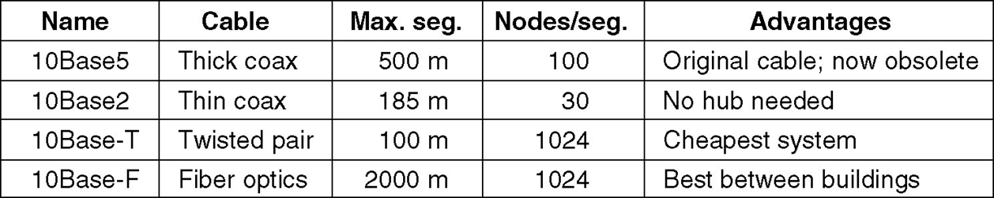
Ethernet Cabling
The most common kinds of Ethernet cabling.

Slide 14
Ethernet Problems
Ethernet’s peak utilization is pretty low (like Aloha)
Peak throughput worst with
More hosts
More collisions needed to identify single sender
Smaller packet sizes
More frequent arbitration
Longer links
Collisions take longer to observe, more wasted bandwidth
Efficiency is improved by avoiding these conditions

Slide 15

Summary
Ethernet

